Slide 1


Farmer’s Market
Price & Sales Tracker
Java Mini Project
Jayaram M • Daivansh V
21 September 2026
Notes:
Good morning everyone. My name is Daivansh, and this is my teammate Jayaram. Today we will present our Java mini project. It is called Farmer's Market Price and Sales Tracker.

Slide 2




Abstract
A simple Java program that helps farmers keep track of their crop sales.
Add sales
View records
Highest price
Money summary
Enter the crop name, kilograms sold and price per kilogram.
See all the saved sales whenever you need them.
Find the crop with the highest selling price.
Get the total revenue, expenses and net profit.
Built with:
Arrays
Loops
Methods
If statements
Switch cases
Scanner
Farmer’s Market Price & Sales Tracker
Notes:
Our project is a simple Java program that helps farmers keep track of their crop sales.
The user can enter the crop name, how many kilograms were sold, and the price per kilogram. The program saves this information and shows all the records when we need them.
It can also find the crop with the highest selling price. It can calculate the total revenue, the expenses, and the net profit.
There is a simple menu, so the user can pick any option easily. In this program we used arrays, loops, methods, if statements, switch cases, and the Scanner class for user input.
In short, this program keeps sales information organized and makes basic calculations easy for farmers.

Slide 3



Understanding the Problem Statement
The problem
Our solution
Farmers sell many different crops every day.
Writing every sale in a notebook is slow and hard.
It is not easy to work out the total money earned.
Add and view sales records.
Calculate the total revenue.
Find the profit after taking away expenses.
Our aim: a simple, easy system that keeps a farmer’s money records neat and organized.
Farmer’s Market Price & Sales Tracker
Notes:
Farmers sell many different crops every day. Writing all the sales in a notebook can be difficult. They have to note the crop name, the quantity, and the price, and then work out how much money they earned.
Our project makes this work easier. The user can add sales, view all sales, calculate the total revenue, and find the profit after taking away the expenses.
Our main aim was to build a simple system that farmers can use easily to keep their money records neat and organized.

Slide 4



CO1 Topics
Data types
Variables
Operators
String
double
cropName
quantity
Arithmetic
Relational
int
boolean
pricePerKg
revenue
expenses
profit
They tell Java what kind of value we store. cropName is a String. pricePerKg is a double.
These are the names where we keep the crop details and the money numbers.
Arithmetic: calculates money, like multiply and subtract.
Relational: compares values, like finding the highest price.
Farmer’s Market Price & Sales Tracker
Notes:
Now let us see the Java concepts we used. First, CO1.
For data types, we used String, double, int, and boolean. For example, the crop name is a String, and the price is a double.
For variables, we used cropName, quantity, pricePerKg, revenue, expenses, and profit.
For operators, we used arithmetic operators like multiply and subtract to calculate money. We also used relational operators to compare values, like finding the highest price.

Slide 5






CO2 Topics
Input with Scanner
If statement
If-else idea
sc.nextLine()
if (sales.isEmpty())
if ... else
nextLine() reads text. nextDouble() reads decimals. nextInt() reads whole numbers.
Checks if there are any sales records yet.
Shows the records if they exist. Otherwise it says there is no data.
Switch statement
Loops
Break statement
case 1 … case 5
for / do-while
break;
Runs the menu option that the user picks.
for shows all records. do-while keeps the menu running.
Used after every case so the program stops at the right place.
Farmer’s Market Price & Sales Tracker
Notes:
Next is CO2.
For input, we used the Scanner class. We used nextLine() for text, nextDouble() for decimal numbers, and nextInt() for whole numbers.
We used an if statement to check if there are any sales records. The code is: if sales dot isEmpty. If the list is empty, the program tells the user that there is no data yet.
We used a switch statement for the menu. It has choices up to case 5, and each case does one job. We used a break statement after every case so the program does not run into the next case.
We also used loops. The for loop shows all the records. The do-while loop keeps the menu running until the user chooses to exit.

Slide 6

CO3 Topics
Methods
ArrayList
Each method does one job.
ArrayList<Sale> sales stores many sales. It grows by itself.
addSale()
Adds a new sale
sales.add(...)
Adds a new record
displaySales()
Shows all sales
sales.isEmpty()
Checks if the list is empty
calculateRevenue()
Finds total money earned
sales.size()
Tells how many records
calculateProfit()
Finds the profit
sales.get(i)
Gets one record at position i
Farmer’s Market Price & Sales Tracker
Notes:
Finally, CO3.
We used methods to keep the code clean. Each method does one job. addSale() adds a new sale. displaySales() shows all sales. calculateRevenue() finds the total money earned. calculateProfit() finds the profit.
To store many sales, we used an ArrayList called sales. It is better than a normal array because it grows automatically.
We used a few ArrayList methods. sales.add() adds a new record. sales.isEmpty() checks if the list is empty. sales.size() tells us how many records there are. And sales.get(i) gives us one record at position i.

Slide 7


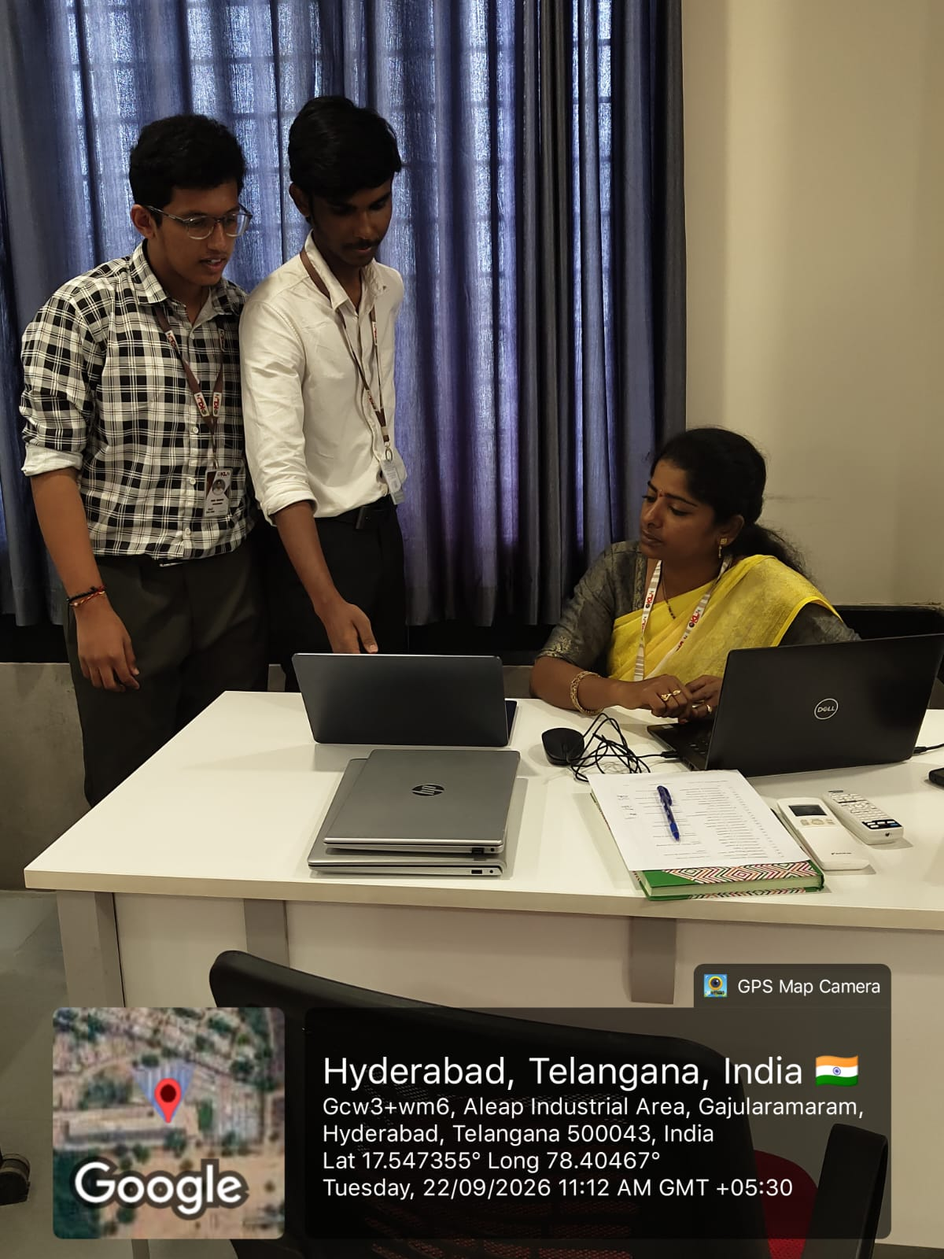
Geo Tag Photo & GitHub Link
Geo Tag Photo
GitHub Link
Add your project photo here
https://github.com/daivanshnikith-star/Java-Project-1
https://github.com/jayaram7-source/java-project-1
Farmer’s Market Price & Sales Tracker
Notes:
On this last slide, you can see our geo-tagged project photo and our GitHub link. You can open the link to see our full code.

Slide 8
Thank You
Any questions?
Jayaram M • Daivansh V
Notes:
That is our project. Thank you for listening. We are happy to answer any questions.

